Slide 1
BANK ACCOUNT SYSTEM
University Of Karachi
Department Of Computer Science
Group Members:
Syed Safi Haider B15101139
Muhammad Ahsan B15101056
Abdul Basit B15101003
Muhammad Junaid Siddiqui B15101077
Course Supervisor: Dr. Humera Tariq

Slide 2
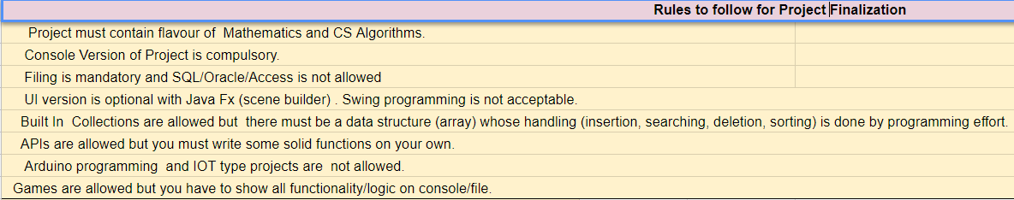
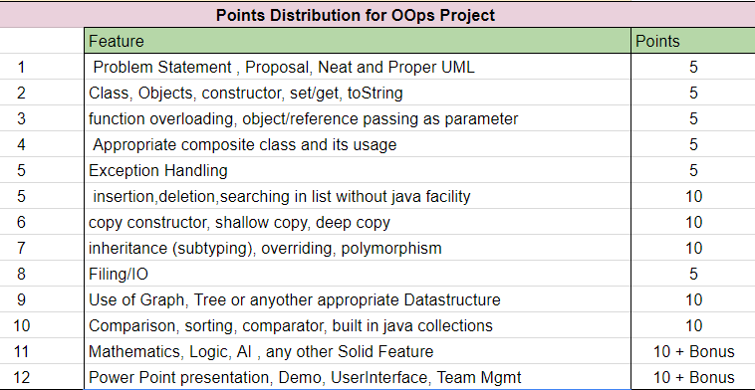

Slide 3
Contents
Introduction
Problem Statement
Why It is important to Solve the Chosen Problem?
Sample Input
Sample Output
Filing
UML Diagrams
UML of Main Class
UML Showing Association between Classes
UML Showing Composition between Classes
UML Showing Inheritance between Classes
UML Showing Filing
UML Showing Exceptions
Overall UML Diagram of System
Attributes Handling
Private
static
final
Code snippets of Constructor calling different types
Code Snippets of Copy
Shallow copy Concept
Deep Copy Concept
Code Snippets of Function Calling
Showing Object passing as parameter
Showing Object returns from function in class
Code Snippets of Overloading
Code Snippets of using arrays
Array of Objects
Polymorphic Array
ArrayList
Code Snippets of Overriding
Code Snippets of Type Casting and Boxing-unBoxing
Exceptions
Learning and achievements
Improvement and Future Work
Demo and Queries
Singleton Pattern (Bonus)
Composite Pattern( Bonus) Java Fx GUI (Bonus)
MVC Pattern (Compulsory)---Organizing your code into multiple folders namely Model, View and Controller

Slide 4
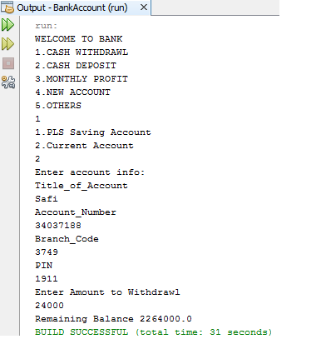
introduction
In this project we made an BANK ACCOUNT SYSTEM which helps you secure your money and invest your amount for better future and withdraw or deposit your amonut easily.

Slide 5
Problem Statement
The objective of the project is to get rid of bank timings and automate transaction easily using an application
BSCS-415 Object Oriented Programming

Slide 6
Importance
To Solve the given Problem is important because nobody wants to waste his/her time on bank timings.

Slide 7
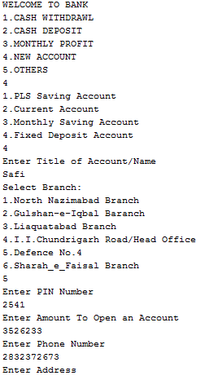
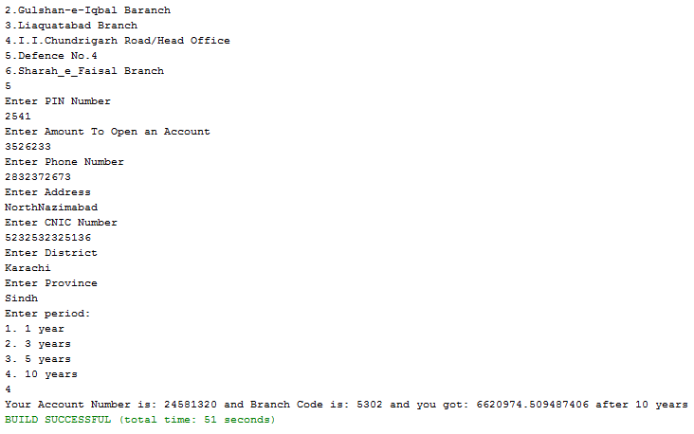
Sample Input

Slide 8
Sample Output
It is the output file view of previous input.

Slide 9
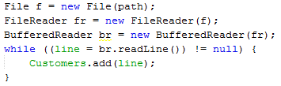
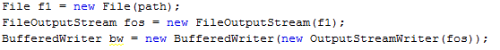
Filing
Each type of account has separate file and in this project we can read , write , update and edit from file.

Slide 10
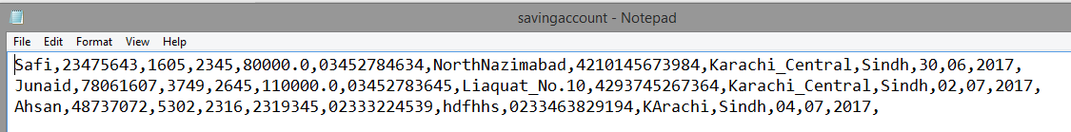
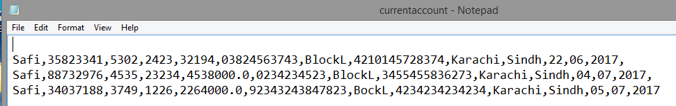

Slide 11
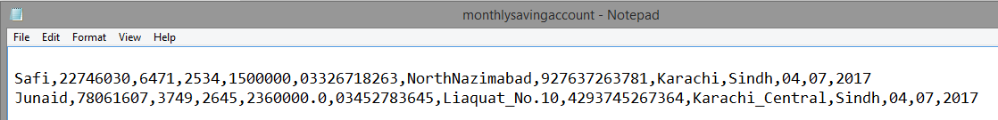
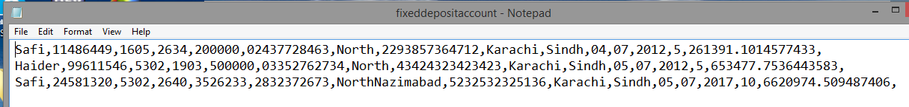
UML Diagrams
In this section we describe Module Wise UML of important classes and UML of relationship between classes.

Slide 12
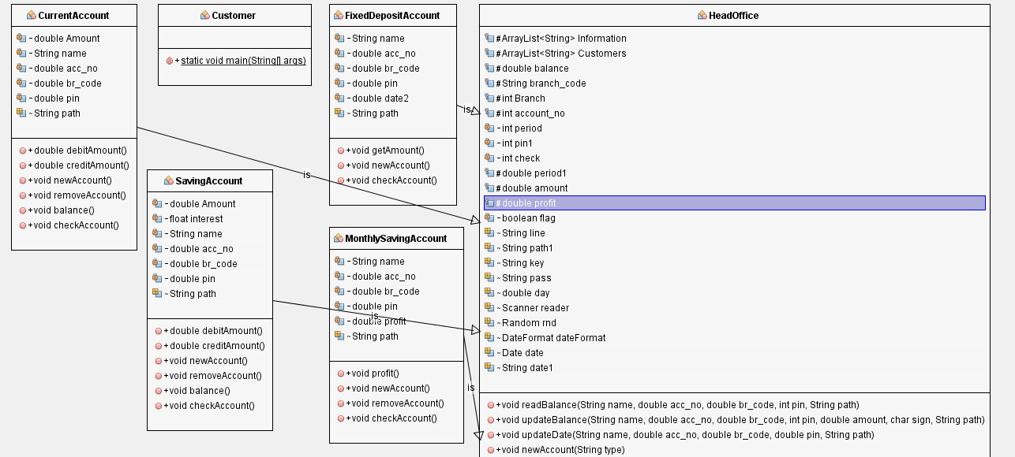

Slide 13
UML for Processing Module

Slide 14
UML for Output Module

Slide 15
Another UML representing your Module

Slide 16
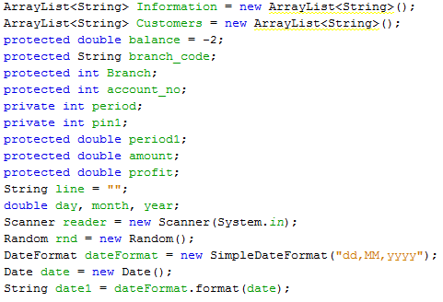
Attribute Handling
It is a snapshot of class headoffice and attributes are kept protected so that its classes (savingaccount,currentaccount,monthlysavingaccount,fixeddepositaccount)
can access these attributes

Slide 17
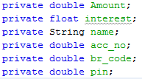
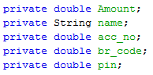
These attributes refers to class savingaccount and the attributes are kept private so they must be accessible within class
These attributes refers to class currentaccount and the attributes are kept private so they must be accessible within class

Slide 18
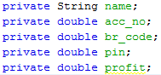
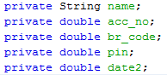
These attributes refers to class monthlysavingaccount and the attributes are kept private so they must be accessible within class
These attributes refers to class fixeddepositaccount and the attributes are kept private so they must be accessible within class

Slide 19
Constructor calling and function calling
In this section we described how we invoke functions to accomplish certain task. We also talked about parameter passing especially object passing as parameter and object returning from function.

Slide 22
Overloading
In this Section we demonstrate method overloading.

Slide 25
Array of Similar objects
Here we describes the grouping of similar objects via arrays, list and other containers

Slide 27
Inheritance and polymorphism
Here we describe about Interface, Abstract Class, Inheritance, Polymorphism, Polymorphic Array and Overriding.

Slide 29
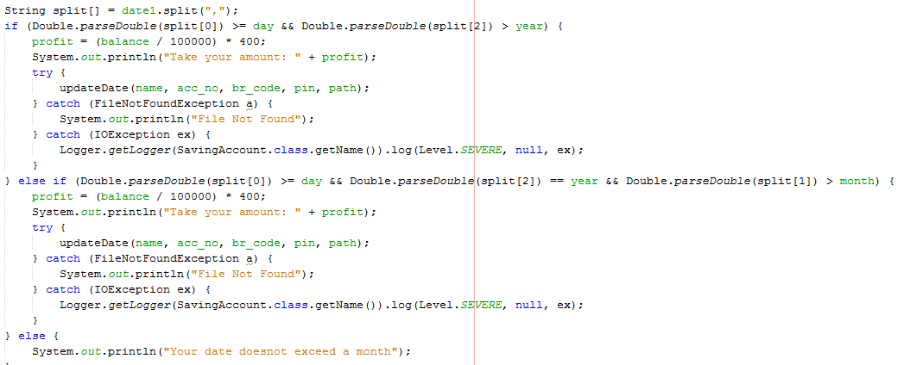
Mathematics, logic , data structure
It is a part of monthlysavingaccount in which we calculate monthly profit depending upon the current interest rate of the bank. You cannot withdraw your amount before a month.

Slide 30
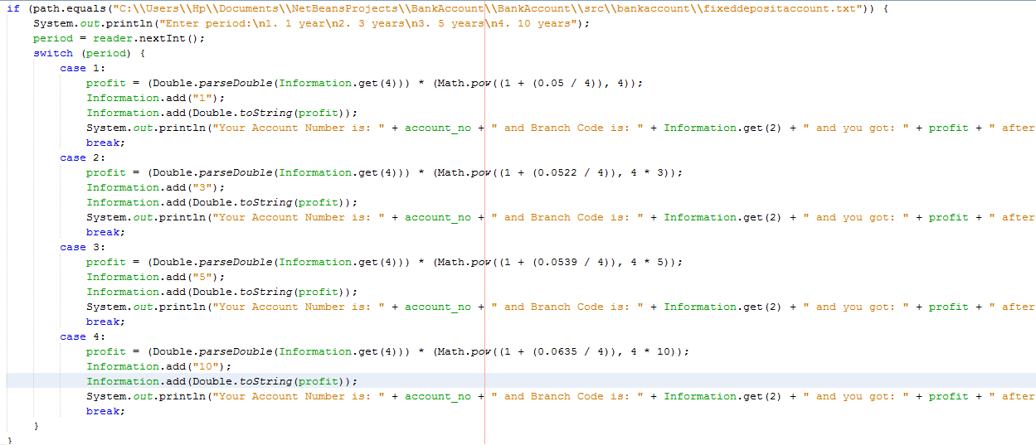
This is the part of new account function in class headoffice and it only use for fixed deposit account. In this function we calculate the final amount depending on the interest rate of 1 year/3 years/5years/10 years and quarterly compound interest added every year to the profit. You cannot withdraw your amount before chosen time period of fixed amount.

Slide 31
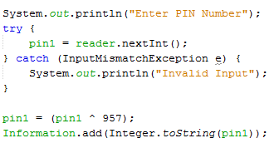
Encryption & Decryption
We use encryption decryption in pin number. While creating new account your pin number doesn’t save directly rather its encrypted version save in file for security purpose.
While performing transaction it reads pin number from account and decrypt it for checking authentic pin number entered by the user.

Slide 32
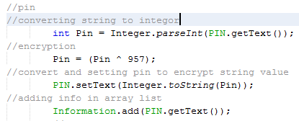
Encryption IN GUI
We have used encryption for saving an encrypted pin in a file so that if our file have been stolen then the saved pin would be encrypted and for performing transaction our app decrypted pin at run time(where as decryption is same as console application)

Slide 33
Learning and Achievements
The things we have learned is that how to make application using java how to link coding to user interface how to deal or solve real life problem using java

Slide 35
Improvements and future work
We will try to improve limit of text field length ,run time comparison of text field making shortcut keys for accounts connect it to websites length of text field handlings etc

Slide 36
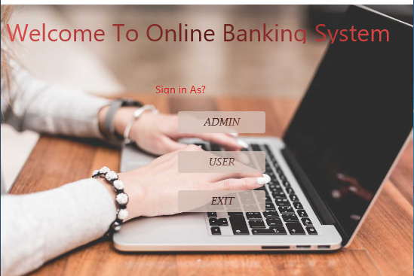
Demo and Queries
Main page

Slide 37
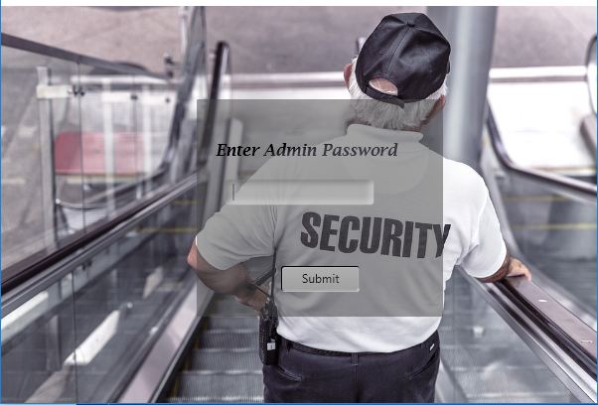
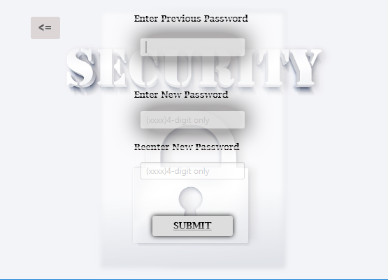
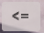
ADMIN INTERFACE
Admin’s security password
Admin’s changing password

Slide 38
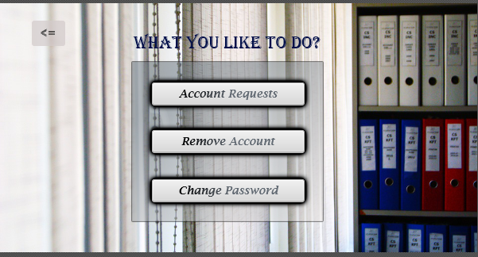
Admin’s Main Page

Slide 39
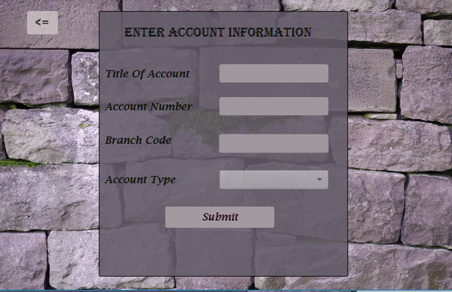
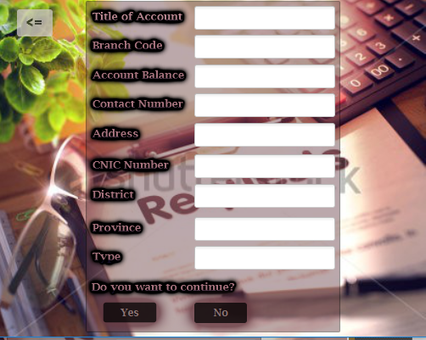
Checking Account Requests
Removing Account
Account request

Slide 40

User Interface
User main window

Slide 41
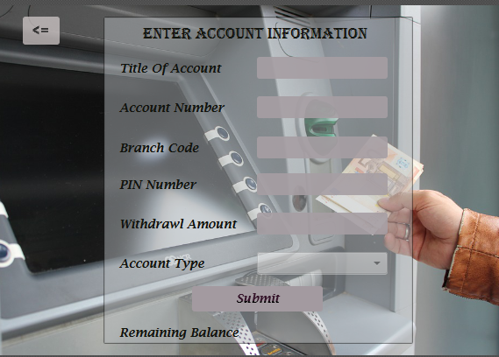
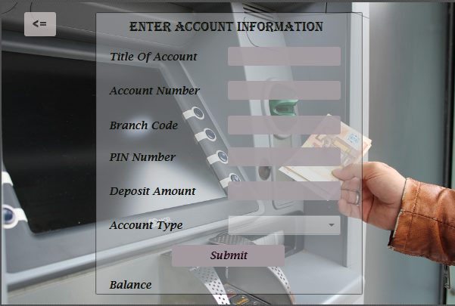
Users Services
Cash with drawl
Cash deposit

Slide 42
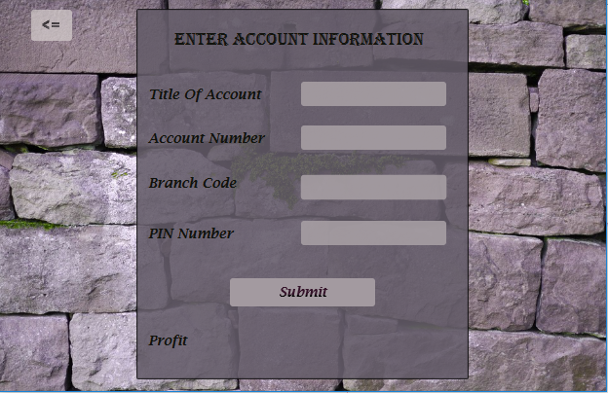
Monthly Profit
It takes information from user and return a monthly monthly profit

Slide 43
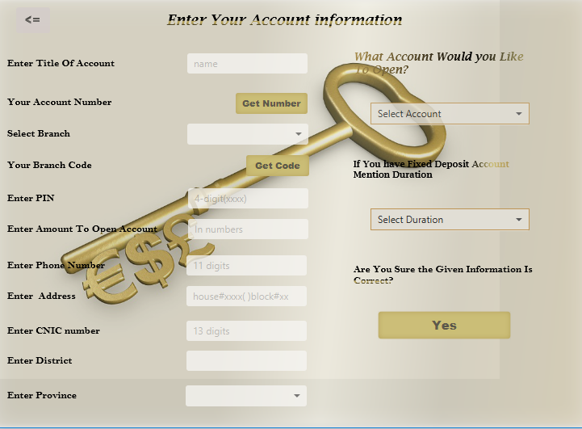
New Account window

Slide 44
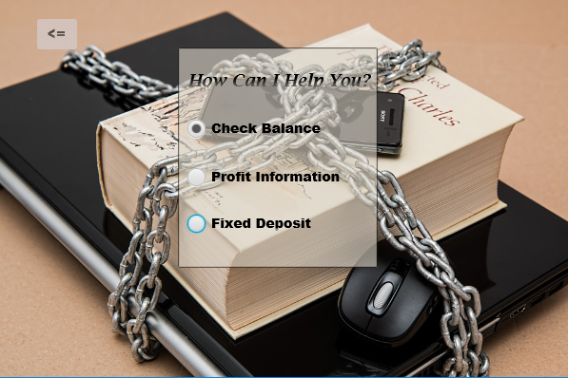
Others Main Window

Slide 45
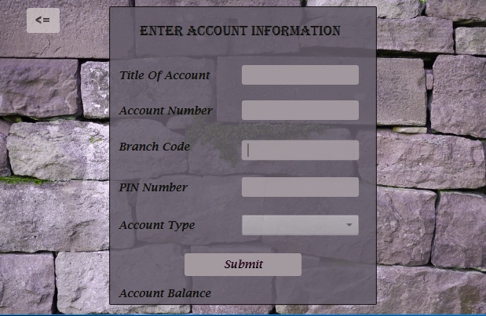
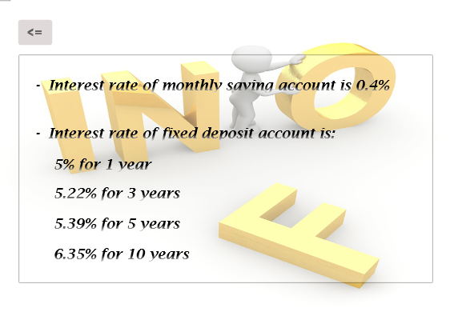
Check Balance
Profit Information

Slide 46

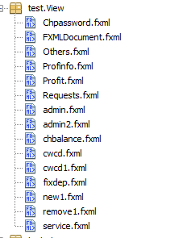
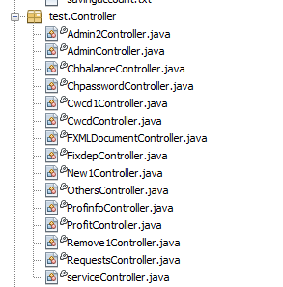
MVC(Model View Controller)
Model in test Package
View In test Package
Controller in test package

Slide 47
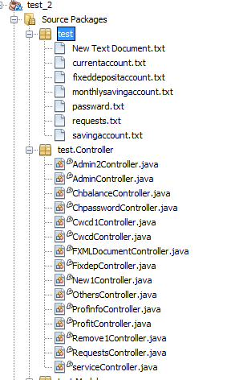
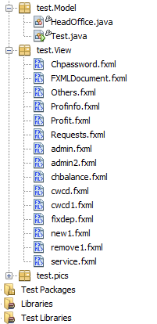
Over View Of MVC

